Slide 1
a) Distribution by environment
c
a
b
c
60
50
40
Disease Severity (%)
30
20
10
0
Controlled
Conditions
2018
2019
2020
Environment

Slide 2
a) DS in field 2018
140
120
Messire
100
80
Nº pea accessions
60
40
20
0
5
10
15
20
25
DS range

Slide 3
b) DS in field 2019
120
Messire
100
80
60
Nº pea accessions
40
20
0
0
10
20
30
40
DS range

Slide 4
c) DS in field 2020
80
60
Messire
Nº pea accessions
40
20
0
0
10
20
30
40
50
DS range

Slide 5
d) DS in Controlled Condition
100
80
60
Nº pea accessions
40
Messire
20
0
0
10
20
30
40
50
DS range

Slide 6
a)
a)
a)
a)
Mean = 28.9
H² = 0.86
b)
Mean = 20.1
H² = 0.46
c)
Mean = 20.5
H² = 0.67
d)
Mean = 27.9
H² = 0.81
80
60
Messire
Messire
Messire
Messire
Number of genotypes
40
20
0
20
40
60
20
40
60
20
40
60
20
40
60
Controlled Condit. (DS range)
Co – 2018 (DS range)
Co – 2019 (DS range)
Co – 2020 (DS range)

Slide 7
e)
Mean = 12.4
H² = 0.76
f)
Mean = 6.6
H² = 0.76
g)
Mean = 3.8
H² = 0.67
h)
Mean = 0.966
H² = 0. 34
100
Number of genotypes
Messire
Messire
Messire
Messire
50
0
5
10
15
20
25
5
10
3
3.5
4
0.95
0.96
0.97
0.98
AUDPC (BLUPs)
IF (BLUPs)
IT (BLUPs)
LP₅₀ (BLUPs)

Slide 8
a
b
c
d
H² = 0.86
CV_{g}= 63 %
H² = 0.63
CV_{g}= 36 %
H² = 0.74
CV_{g}= 49 %
H² = 0.80
CV_{g}= 57 %
75
50
Number of genotypes
25
0
0
20
40
60
20
40
60
20
40
60
20
40
60
Disease severity (CC)
Disease severity (2018)
Disease severity (2019)
Disease severity (2020)
e
f
g
h
H² = 0.73
CV_{g}= 41 %
H² = 0.76
CV_{g}= 47 %
H² = 0.67
CV_{g}= 36 %
H² = 0.34
CV_{g}= 11 %
100
Number of genotypes
50
0
0
3
6
9
25
50
75
100
125
3.0
3.5
4.0
8.5
9.0
9.5
10.0
MDPr
Infection frequency
Infection type
Latency period

Slide 9
e
Gen = 48 %
H² = 0.76
f
Gen = 47 %
H² = 0.76
g
Gen = 36 %
H² = 0.67
h
Gen = 11 %
H² = 0. 34
100
100
Messire
Messire
Messire
Messire
Number of genotypes
count
50
50
0
1
100
200
300
400
5
25
50
75
100
3
3.5
4
8.5
9
9.5
10
AUDPC
IF
IT
LP₅₀
0
0.2
0.4
0.6
0.8
1.0
MDPr

Slide 10
e
Gen = 41 %
H² = 0.73
f
Gen = 47 %
H² = 0.76
g
Gen = 36 %
H² = 0.67
h
Gen = 11 %
H² = 0. 34
100
Messire
Messire
Messire
Messire
Number of genotypes
50
0
2
4
6
8
10
5
25
50
75
100
3
3.5
4
8.5
9
9.5
10
MDPr
IF
IT
LP₅₀

Slide 11
e
Gen = 48 %
H² = 0.76
f
Gen = 47 %
H² = 0.76
g
Gen = 36 %
H² = 0.67
h
Gen = 11 %
H² = 0. 34
100
Messire
Messire
Messire
Messire
Number of genotypes
50
0
1
100
200
300
400
5
25
50
75
100
3
3.5
4
8.5
9
9.5
10
AUDPC
IF
IT
LP₅₀

Slide 12
P. sativum subsp. transcaucasicum Govorov
a
P. sativum subsp. jomardii (Schrank) Kosterin
ab
P. sativum subsp. elatius var. elatius (M. Bieb.) Alef.
q
P. sativum subsp. elatius (M. Bieb.) Asch. & Graebn.
a
P. sativum subsp. cinereum Govorov
c
P. sativum subsp. thebaicum
a
P. sativum subsp. sativum var. sativum
c
Species
P. sativum subsp. sativum var. arvense (L.) Poir.
P. sativum subsp. sativum
q
P. sativum subsp. elatius var. pumilio Meikle
q
P. sativum subsp. elatius (M. Bieb.) Asch. & Graebn.
q
P. sativum L.
q
P. fulvum Sm.
q
P. abyssinicum A. Braun
q
10
20
30
40
50
Disease Severity (BLUPs)

Slide 13
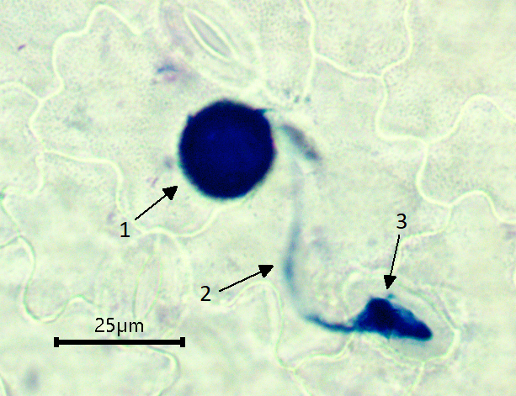
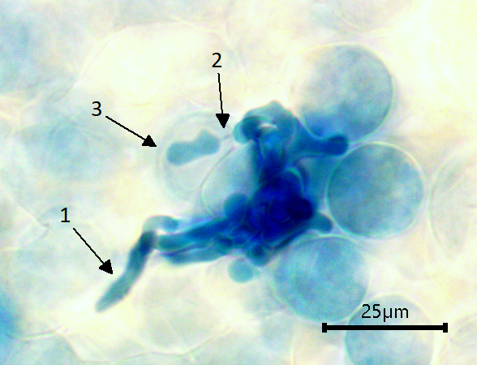
a)
b)

